Slide 1


SMART INDIA HACKATHON 2025
SAFEROUTETECH
Problem Statement ID – 25008
Problem Statement Title- Disaster Preparedness and Response Education System for Schools and Colleges
Theme- Disaster Management
PS Category- Software
Team ID-
Team Name (Registered on portal): SafeRouteTech

Slide 2


















SafeRouteTech
SafeRouteTech
Client Req/Res
Data Retrieval
Proposed Solution
Centralized Alert System: The system continuously monitors official disaster alerts (earthquake, flood, cyclone, fire). When a disaster is detected, instant notifications are sent to: School and college principals, Teachers and staff.
Real-Time Notification: Notifications are delivered through: Mobile app, SMS , Web dashboard.
Evacuation Map: Directions are provided using GPS and maps, making evacuation faster and safer.
Training Module: The system includes pre-disaster education content are Disaster safety guidelines, Do’s and Don’ts and Mock drill instructions
Scalable & Low-Cost Solution: Can be deployed in Schools, Colleges and Universities. Designed to work even in low-resource environments.
Client system
Authentication
Server Req/Res
Services
End Users
SMS
Student
Push Notification
Teacher
Google Maps API
Principal
Faculty staff
Operators
NDMA
Authorized Emergency Control Centre

Slide 3

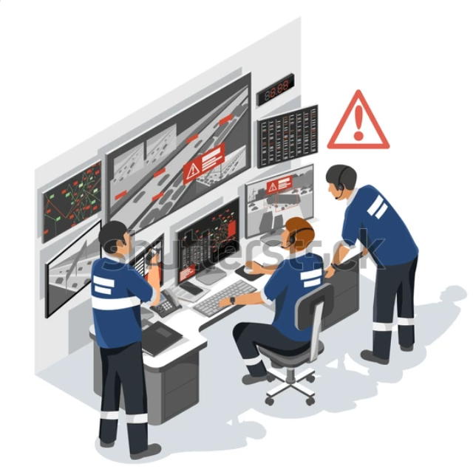










TECHNICAL APPROACH
SafeRouteTech
Technology Stack
Frontend: HTML5, CSS3, JavaScript, React.js, Android.
Backend: Python (Django / Flask), REST APIs, Node.js, MySQL, MongoDB, FCM(Firebase Cloud Messaging), Twilio SMS API, Email SMTP Service.
API Services: Google Maps API, OpenStreetMap, GPS Services.
Authentication: JWT(JSON Web Token), RBAC, HTTPS/SSL.
Cloud and Deployment:: AWS/ Google Cloud Platform(GCP), Firebase Hosting, Docker
Add Ons: Prometheus, Grafana, Logstash.
IMD(weather Alerts)
NDMA
Local Disaster Control Room
Python Django
Backend Server
Flask
MySQL
FCM
Google Mapas API
JavaScript
Fronted Web / Mobile
CSS
Principal / Admin
Teachers & Staff
Students / parent

Slide 4





FEASIBILITY AND VIABILITY
SafeRouteTech
Feasibility
Uses existing technologies (mobile apps, cloud, GPS, maps)
Disaster alerts can be integrated from government or authorized sources
Real-time notifications via SMS and push alerts are technically reliable
Easy to deploy and maintain with minimal infrastructure
Use Cases
Flood evacuation guidance for schools in low-lying areas
Earthquake response and safe assembly mapping
Fire emergency evacuation in campuses
Mock drills and disaster preparedness training
Viability
High relevance due to increasing natural disasters
Suitable for schools and colleges as part of safety compliance
Scalable from institution level to city or state level
Long-term usability through regular safety training and updates
Business Potential
Subscription model for schools and colleges
Government and education board partnerships
Licensing to private institutions and universities
Potential integration with insurance and disaster management agencies
Challenges
Dependence on accurate and timely disaster data
Internet or power failure during severe disasters
User training and awareness adoption
Data privacy and security concerns

Slide 5
IMPACT AND BENEFITS
SafeRouteTech
Benefits of the solution
Potential impact on the target audience
Students
Faster access to safe evacuation routes
Reduced panic during emergency situations
Improved awareness and understanding of disaster safety
Teachers
Instant disaster notifications and clear instructions
Better ability to manage and guide students safely
School & College Administration (Principals)
Centralized control and real-time situation awareness
Improved compliance with safety regulations
Faster coordination with local authorities
Parents & Guardians
Greater trust in institutional safety systems
Better information flow from institutions
Safety improvement
Panic Reduction
Awareness & Education
Faster Response
Institutional Efficiency
Social
Benefits of the solution
Provides real-time disaster alerts to schools and colleges
Guides users with safe evacuation routes using maps
Reduces panic, confusion, and response time during emergencies
Improves student and staff safety
Helps teachers and principals take quick and informed decisions
Supports organized evacuation and crowd management
Enhances disaster awareness and preparedness education
Low-cost, scalable, and easy to implement
Works for multiple disaster types (flood, fire, earthquake)
Builds trust among parents and authorities

Slide 6
RESEARCH AND REFERENCES
SafeRouteTech
Government & Official Sources
National Disaster Management Authority (NDMA) : https://ndma.gov.in India Meteorological Department (IMD) : https://mausam.imd.gov.in National Institute of Disaster Management (NIDM) : https://nidm.gov.in
International Organizations
United Nations Office for Disaster Risk Reduction (UNDRR) : https://www.undrr.org
World Health Organization (WHO) : https://www.who.int/emergencies
Technology References
Google Maps Platform Documentation : https://developers.google.com/maps/documentation
Firebase Cloud Messaging (Push Notifications) : https://firebase.google.com/docs/cloud-messaging
OpenStreetMap (Alternative to Google Maps) : https://www.openstreetmap.org

Slide 7
IMPORTANT INSTRUCTIONS
Please ensure below pointers are met while submitting the Idea PPT:
Kindly keep the maximum slides limit up to six (6). ( Including the title slide)
Try to avoid paragraphs and post your idea in points /diagrams / Infographics /pictures
Keep your explanation precise and easy to understand
Idea should be unique and novel.
You can only use provided template for making the PPT without changing the idea details pointers (mentioned in previous slides).
You need to save the file in PDF and upload the same on portal. No PPT, Word Doc or any other format will be supported.
Note - You can delete this slide (Important Pointers) when you upload the details of your idea on SIH portal.

